Slide 1
Library Management
Jairo Hernandez: Lead Programmer, UML Designer, Presenter

Slide 2
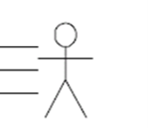
Actors
Staff
Student

Slide 3
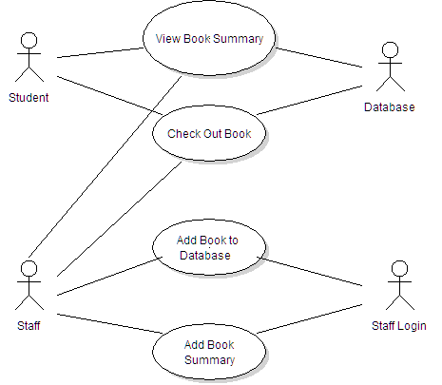
Use Case Diagram

Slide 4
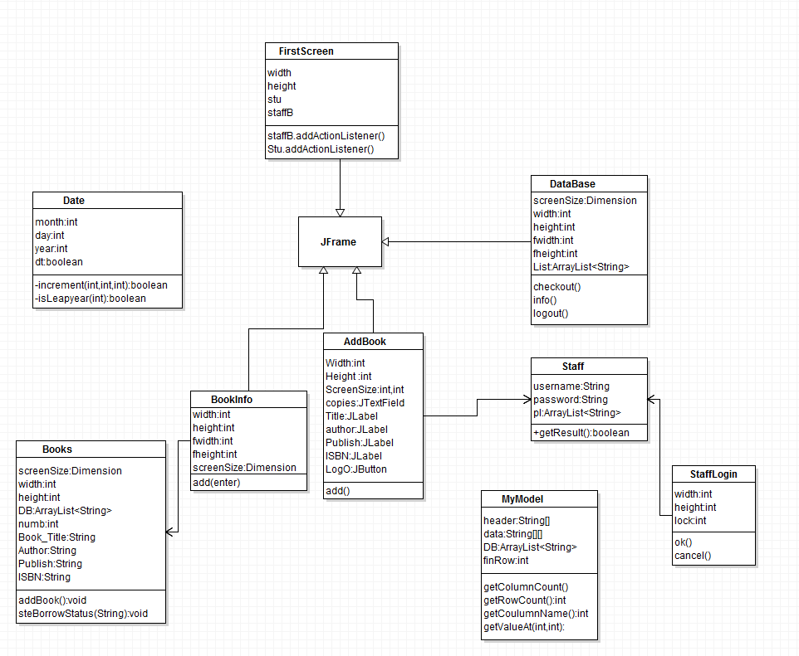
Class Diagram

Slide 5
Lets run the code…

